Slide 1
Introduction
Dang Quang An

Slide 2

Who am I?
Lead/PM Data Scientist at AWL Vietnam
Computer Vision
Product Manager at Viettel
Social Listening Platform (Reputa)
Researcher at John von Neumann Institute
Email: an.dang1390@gmail.com

Slide 3
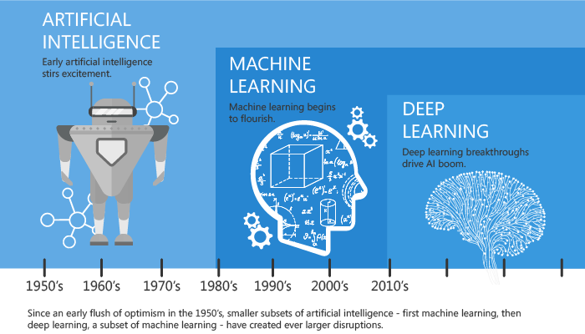
A quick history of Machine Learning
Notes:
1940s when the first manually operated computer system, ENIAC (Electronic Numerical Integrator and Computer)
In the 1950s, we see the first computer game program claiming to be able to beat the checkers world champion
Machine learning became very famous in the 1990s thanks to Statistics

Slide 4
What is Machine Learning?
Arthur Samuel said “Machine Learning algorithms enable the computers to learn from data, and even improve themselves, without being explicitly programmed”
Machine learning (ML) is a category of an algorithm that allows software applications to become more accurate in predicting outcomes without being explicitly programmed. The basic premise of machine learning is to build algorithms that can receive input data and use statistical analysis to predict an output while updating outputs as new data becomes available.

Slide 5
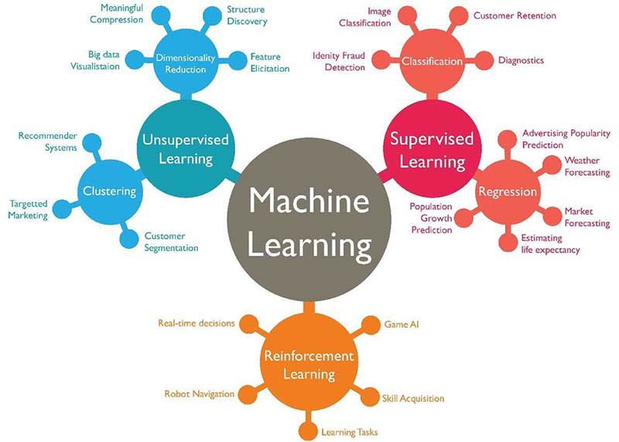
Type of Machine Learning
Association Rules

Slide 6
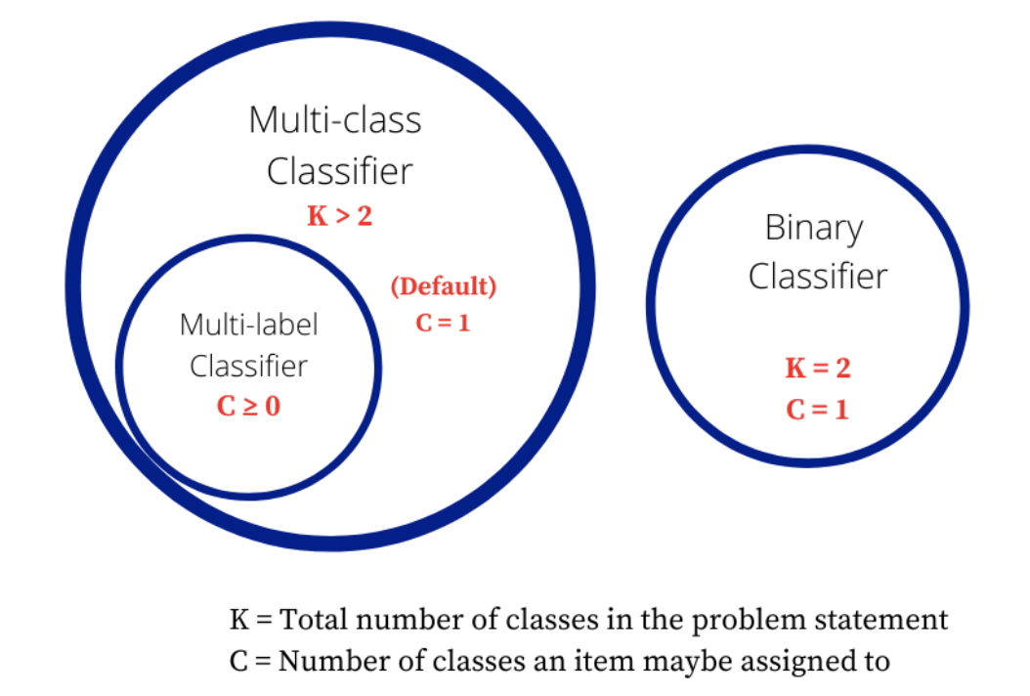
Supervised Learning
Supervised learning is where you have input variables (x) and an output variable (Y) and you use an algorithm to learn the mapping function from the input to the output.
Y = f(X)
Classification: A classification problem is when the output variable is a category, such as “red” or “blue” or “disease” and “no disease”.
Binary Classification
Multi-Class Classification
Multi-Label Classification
Regression: A regression problem is when the output variable is a real value, such as “dollars” or “weight”.

Slide 7
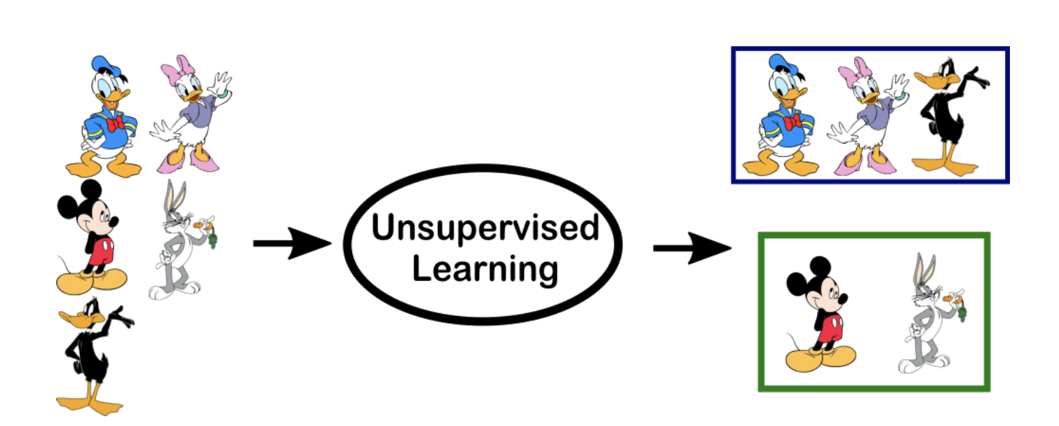
Unsupervised Learning
Unsupervised Learning presented with unlabeled, uncategorized data and the system’s algorithms act on the data without prior training

Slide 8

Reinforcement Learning
A reinforcement learning algorithm, or agent, learns by interacting with its environment. The agent receives rewards by performing correctly and penalties for performing incorrectly. The agent learns without intervention from a human by maximizing its reward and minimizing its penalty. It is a type of dynamic programming that trains algorithms using a system of reward and punishment.

Slide 9
Applications
Recommender in Amazon, Neflix, Shoptify,...
NER (Name Entity Recognition): Identify places, name, actions,... from document
Face ReID
Object Detection for camera surveillance
OCR (Optical Character Recognition)
Search Engine

Slide 10

Data Science Project workflow
Microsoft

Slide 11
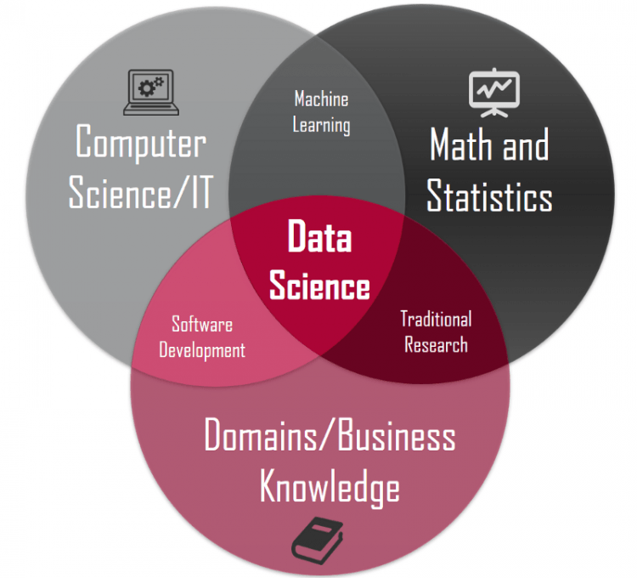
Data Scientist skills

Slide 12
Cons of Data Science
Data Science is a very general term and does not have a definite definition. While it has become a buzzword, it is very hard to write down the exact meaning of a Data Scientist.
Mastering Data Science is near to impossible
Large Amount of Domain Knowledge Required
Arbitrary Data May Yield Unexpected Results

Slide 13
Goal
Understand and can work/investigate in a Data Project
Be able to build classification/clustering model
Be able to choose and explain the models
Enhance the problem solving skill
Enough knowledge and skills for further learning

Slide 14
Homework
Join Kaggle Competition: https://www.kaggle.com/c/titanic
Use any online solutions on Internet
Write a summary report that shows:
Link for the solution
What are the steps and main reasons for each steps?
What is the evaluation metrics and explain them in details?
Try other model which is different than the original model
https://scikit-learn.org/stable/index.html

Slide 15
Frequency used in Data Science
Python: Scikit-learn, Pandas, Dash, PySpark,...
R
SAS/SAP
Excel
Tableau/Power BI
Tensorflow/Pytorch
Weka
H20
AutoML

Slide 16
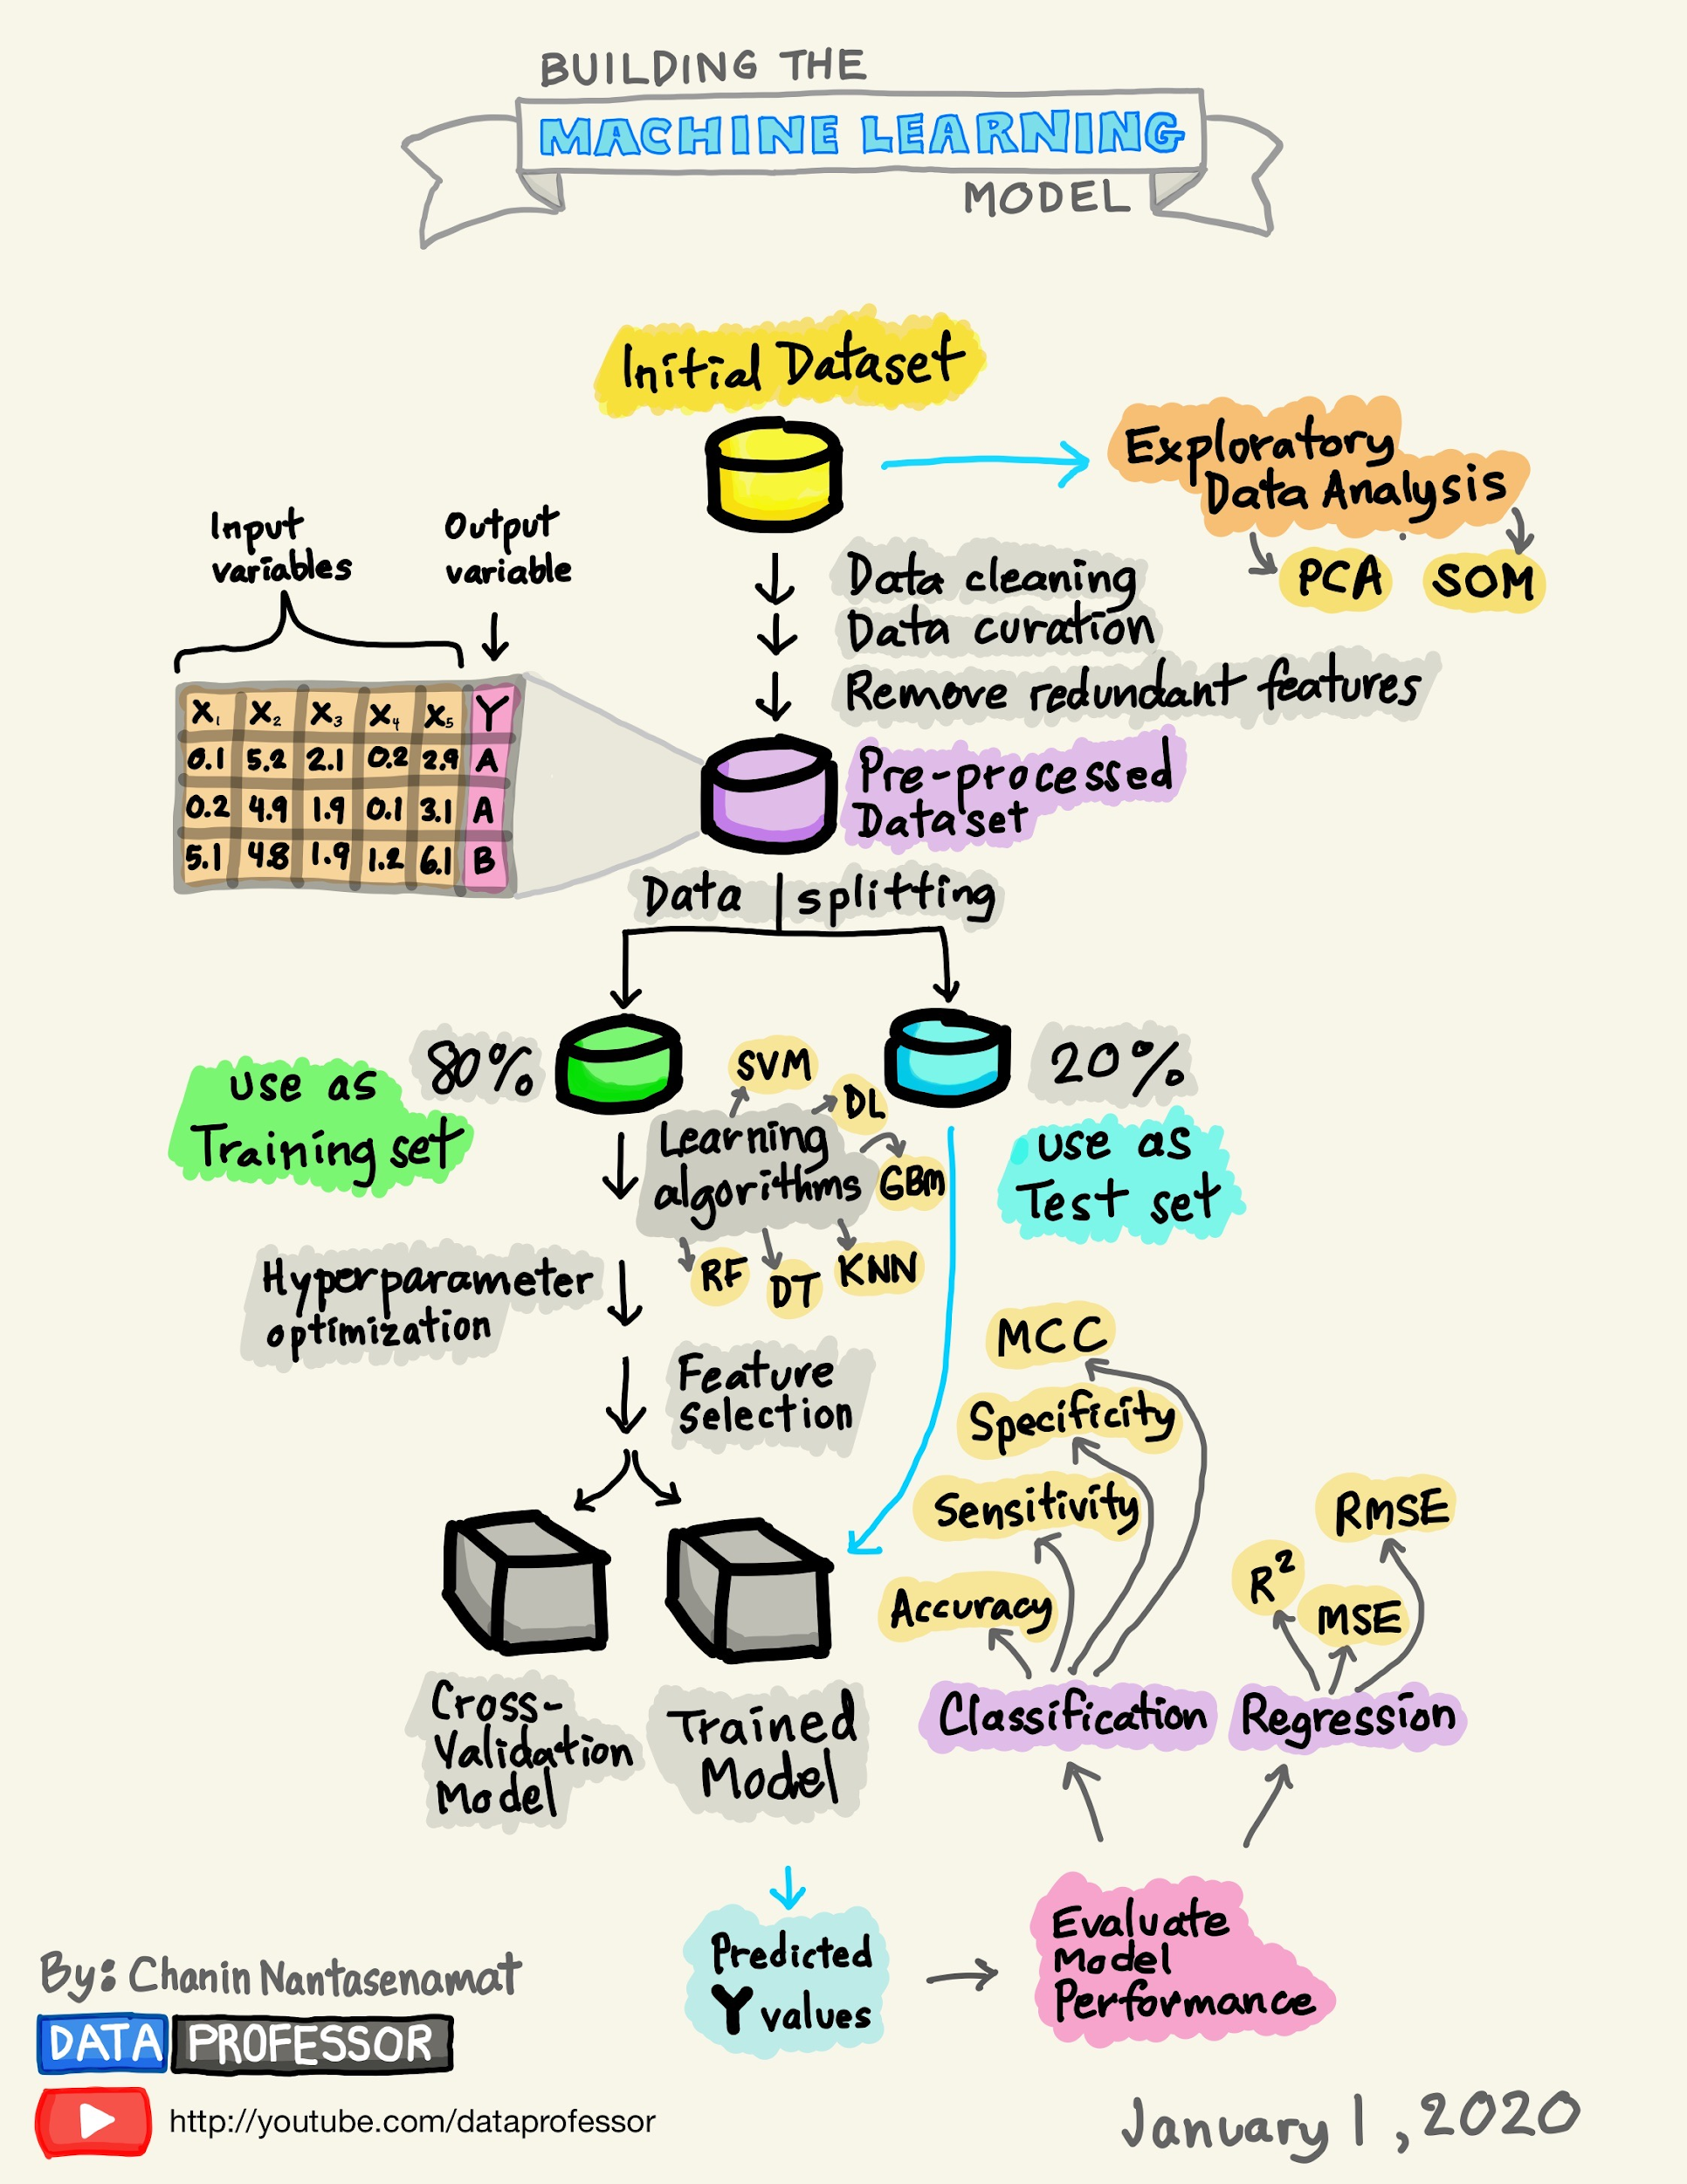
How to build a model

Slide 17
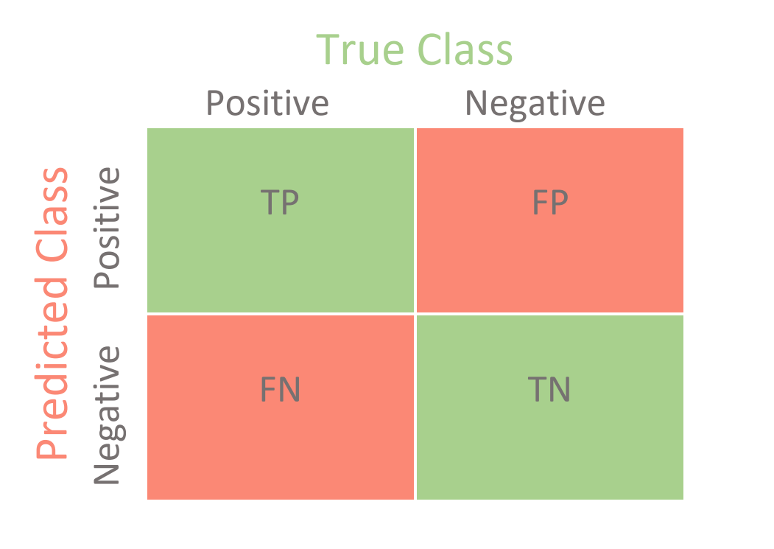
Data Science terminologies
Terminologies
Precision = TP/(TP + FP)
Recall = TP/(TP + FN)
Confusion Matrix
Notes:
Imagine that we want to make sure that our web site blocker for our child only allows 'safe' websites to be shown. In this case, a 'safe' website is the positive class. Here, we want the blocker to be absolutely certain that the website is safe, even if some safe websites are predicted to be part of the negative or unsafe class and are consequently blocked. That is, we want high precision at the expense of recall.
In the case of airport security, where a safety risk is the positive class, we want to make sure that every potential safety risk is investigated. In this case, we will have high recall at the expense of precision (a lot of bags where there are no safety hazards will be investigated).

Slide 18
Set up environment
Set up the conda/miniconda environment: https://docs.conda.io/en/latest/miniconda.html
Create and activate environment
Install packages using:
Pip: pip install -r requirement.txt
Conda

Slide 19
Homework (continue)
Read Apriori Algorithm and Bayes Classifier
Ask questions if not understand

Slide 20
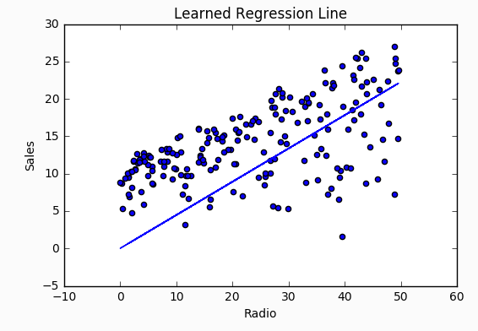
Linear Regression
Linear Regression is a supervised machine learning algorithm where the predicted output is continuous and has a constant slope
Y = F(X)
For example:

Slide 21
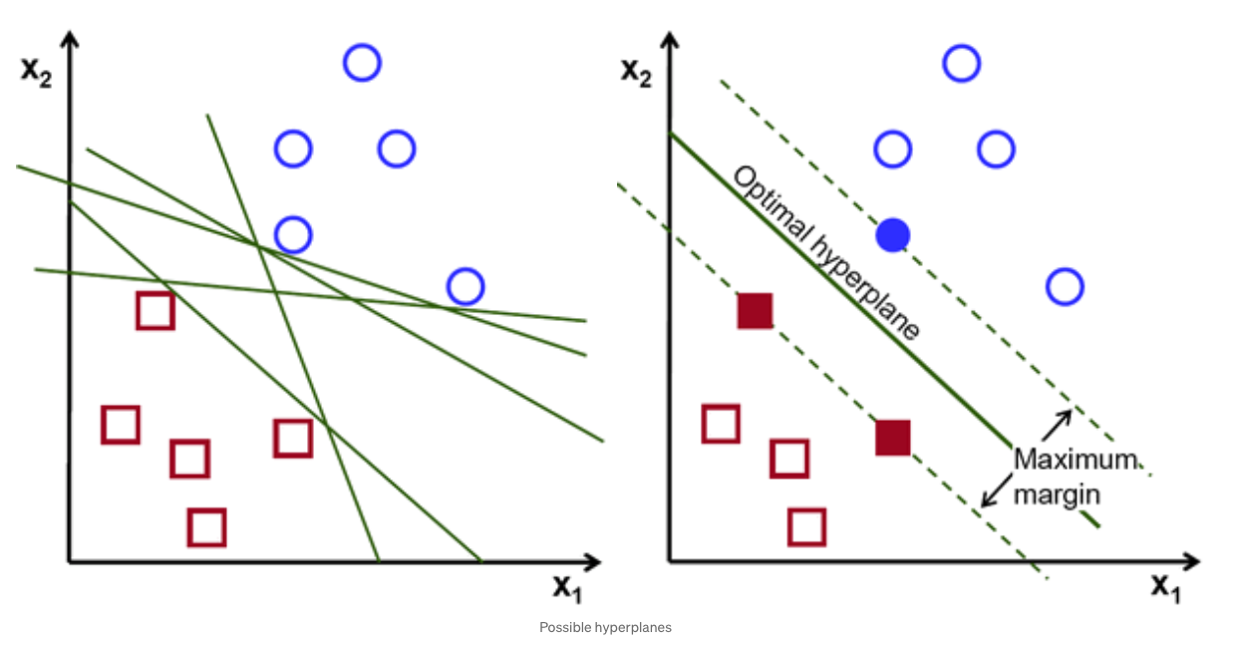
SVM (Support Vector Machine)
The objective of the support vector machine algorithm is to find a hyperplane in an N-dimensional space(N — the number of features) that distinctly classifies the data points.

Slide 22
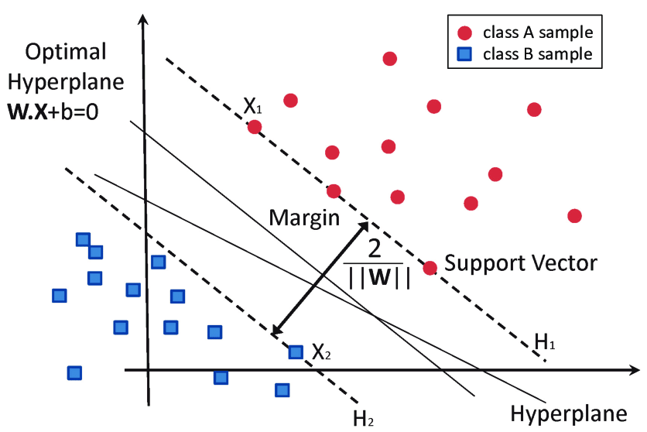
Hyper plane and support Vector

Slide 23
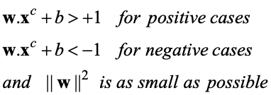
SVM
To find the maximum margin separator, we have to solve the following optimization problem:
This is tricky but it’s a convex problem. There is only one optimum and we can find it without fiddling with learning rates or weight decay or early stopping.
Don’t worry about the optimization problem. It has been solved. Its called quadratic programming.
It takes time proportional to N^2 which is really bad for very big datasets
•so for big datasets we end up doing approximate optimization!

Slide 24
Linear SVM vs Non-Linear SVM
Linear SVM | Non-Linear SVM
It can be easily separated with a linear line. | It cannot be easily separated with a linear line.
Data is classified with the help of hyperplane. | We use Kernels to make non-separable data into separable data.
Data can be easily classified by drawing a straight line. | We map data into high dimensional space to classify.

Slide 25
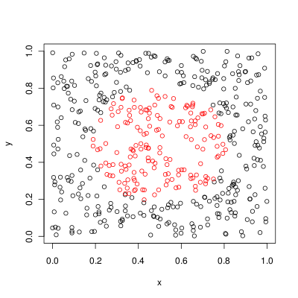
SVM
Can not find a hyperplane that linearly separate data-points.

Slide 26
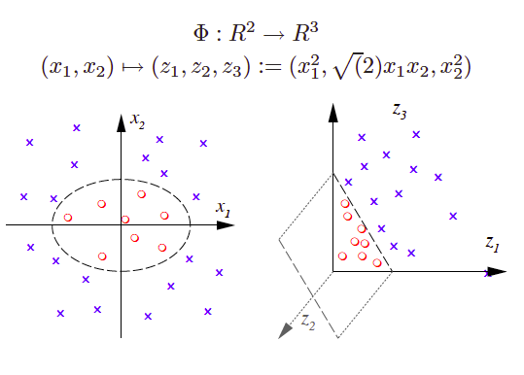
Kernel Function

Slide 27
Exercises
Apply SVM for sentiment classification:
Dataset: tweet1000 csv (1000 documents)
Algorithm: Compare between SVM and Linear Model (accuracy, precision, recall, training time)
Feature extraction : Try both Bag-of-words and TF-IDF.

Slide 28
Homework (continue)
Do you want more Maths in the slides?
Which topics do you want to cover?

